Slide 1
Introduction to Literary Criticism
ENGL 102-A02
Spring 2019
Instructor: Sydora

Slide 2
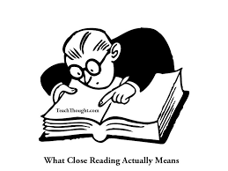
Recap:
Close Reading: examination of how the verbal strategies (literary devices, tone, form, tropes) in a literary text contribute to its meaning.
How does the form contribute to its meaning?
How do the work’s devices enhance meaning?
How does the tone contribute to meaning?
Close reading is one form of
literary analysis that enables
literary criticism.

Slide 3
What is Literary Criticism?
Literary criticism is the analysis of a literary text through a critical lens that advances a particular interpretation of the text.
Purpose of Literary Criticism:
To help resolve a question, problem, or difficulty in reading.
To help decide between conflicting readings of a text.
To help propose a critical interpretation of a text.

Slide 4

Schools of Literary Criticism:
Literary critics argue over the best way to interpret a text.
Different branches of criticism (aka “schools” or “theories”) have different methods of “reading” and forming arguments about texts.
The branch of criticism you use determines the content of your interpretation.
Schools of criticism overlap – they are not exclusive.

Slide 5
General Overview of Schools:
Historical Timeline:
Moral Criticism, Dramatic Construction (~360 BC-present)
Formalism, New Criticism, Neo-Aristotelian Criticism (1930s-present)
Psychoanalytic Criticism (1930s-present)
Marxist Criticism (1930s-present)
Reader-Response Criticism (1960s-present)
Structuralism/Semiotics (1920s-present)
Post-Structuralism/Deconstructionism (1966-present)
New Historicism/Cultural Studies/Media Studies (1980s-present)
Postcolonial Criticism (1990s-present)
Feminist Criticism (1960s-present)
Gender/Queer Studies (1970s-present)
Ecocriticism (1980s-present)
Critical Race Theory (1970s-present)
Source: Allen Brizee, J. Case Tompkins, Libby Chernouski, Elizabeth Boyle.

Slide 6
How do we situate “close reading”?
A method of reading developed by the schools of Russian Formalism and New Criticism.
Basic Principles of New Criticism:
The key to understanding the text is looking only within the text itself.
The form of the text dictates its content.
There is no use for historical or biographical interpretations.
It is essential to practice close reading.

Slide 7
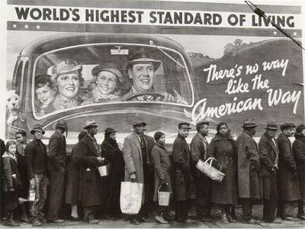
Reading Class, Labour and Capital in America
Bread line circa 1927 highlights the paradox of American nationalism during the Great Depression.

Slide 8
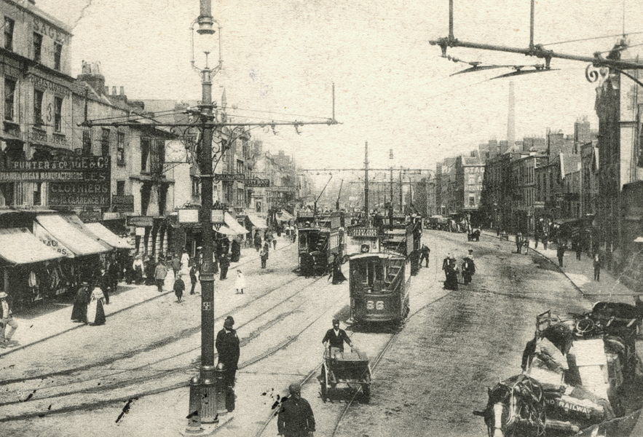
Cultural Changes in 20th Century America
Urbanization and the rise of the city
Technological innovations in transportation, architecture,
and engineering
Increase in population
Development of factory life
Growth of consumerism
and materialism
Change in traditional religious, political, and social values

Slide 9
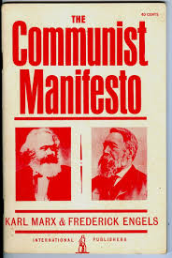
Marxist Criticism: An Overview
Based on the theories of Karl Marx, a Prussian socialist philosopher.
Concerned with the representation
of issues of class difference and class
conflict, as well as the consequences
of the capitalist system.
Literature is a product of its time and
culture.
Published in 1948.

Slide 10
History is a series of struggles between the oppressed (proletariat) and the oppressors (bourgeois) over the distribution of resources.
The dominant classes rely on the lower classes; however, the dominant classes work to keep the oppressed in ignorance of their condition.
Literature will reflect the conflict between socioeconomic classes.
Literature will also reflect the social institutions out of which it emerges.

Slide 11

Questions for Marxist Criticism:
If the literary text is accepted or believed, whom benefits?
What is the social class of the author?
Which class does the work claim to represent?
What values are reinforced or undermined?
Which economic or social issues appear in the text?
To what extent are the characters’ lives determined by social, political, or economic forces? Are they aware of these forces?
How do characters overcome oppression?

Slide 12
Bibliography
Abrams, M.H. "Marxist Criticism." A Glossary of Literary Terms. 7th ed., Harcourt Brace College Publishers, 1999, pp. 147-153.
Brizee, Allen et al. “Marxist Criticism (1930s-present).” The Writing Lab and OWL at Purdue and Purdue U, 21 Apr. 2010. Accessed 11 Sept. 2016.
Delahoyde, Michael. “Introduction to Literature.” WSU.edu. Accessed 12 Sept. 2016.
Eward-Mangione, Angela. “Literary Criticism: An Introduction.” Writing Commons. 14 Jul. 2016, https://writingcommons.org, Accessed 11 Sept. 2016.

